Slide 1
ETAX.COM
YOUR ONLINE CHARTERED ACCOUNTANT TO CALCULATE AND PAY INCOME TAX ON A CLICK.
This site was developed with the aim to digitalize indian online tax paying system.

Slide 2
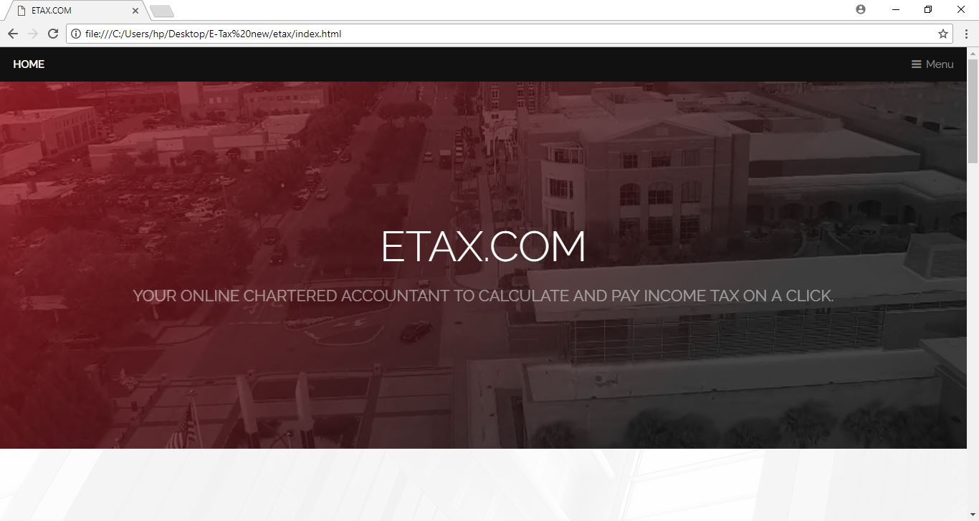
HOMEPAGE

Slide 3
REGISTER FOR ANY FUTURE REFERENCES
REGISTER IF YOU DONT HAVE AN ETAX ID. THIS WILL ENABLE US TO GET QUICK ACCESS TO YOUR DATA TO CALCULATE YOUR INCOME TAX.
IF YOU HAVE ALREADY REGISTERED FOR ETAX.COM , PLEASE LOGIN IN TO YOUR ACCOUNT.

Slide 4
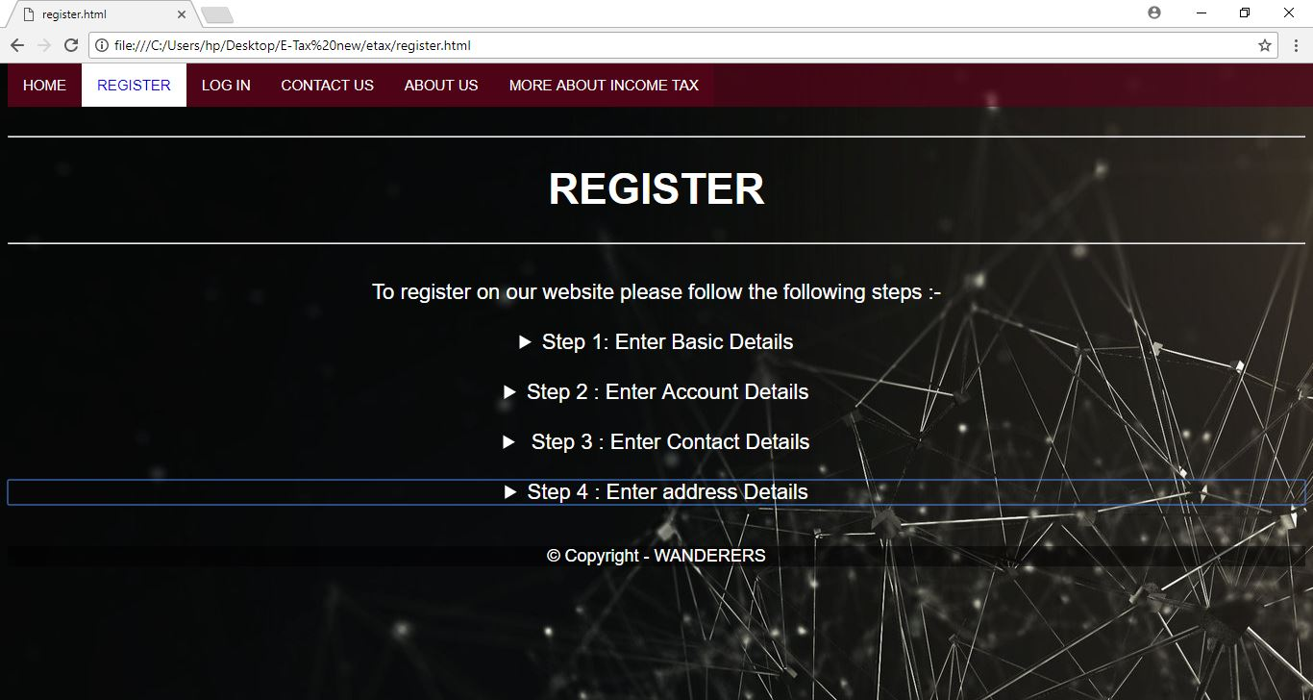
REGISTER PAGE

Slide 5
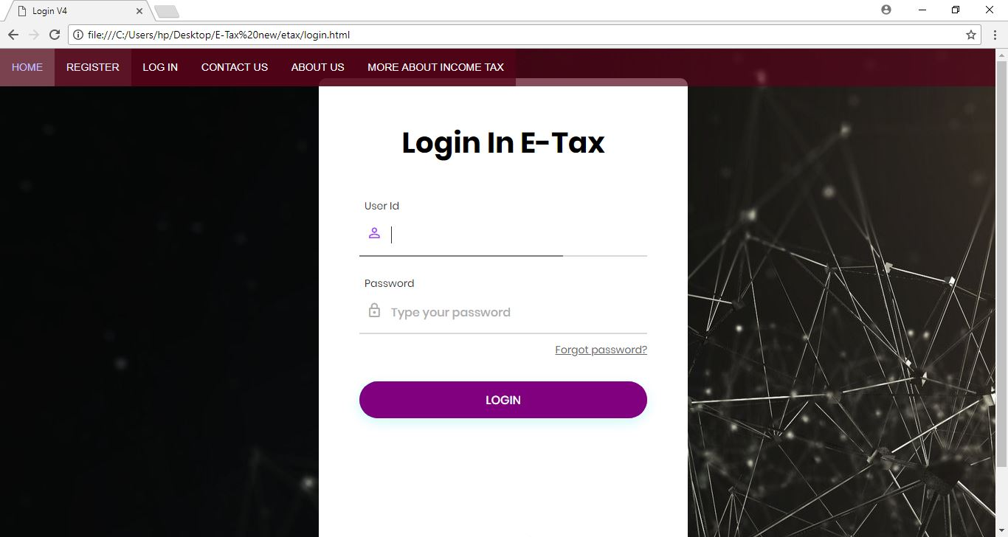
LOGIN

Slide 6
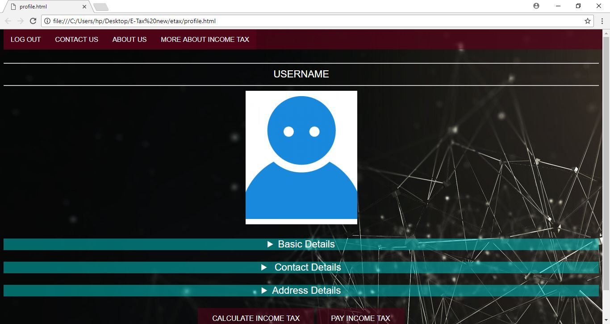
PROFILE PAGE

Slide 7
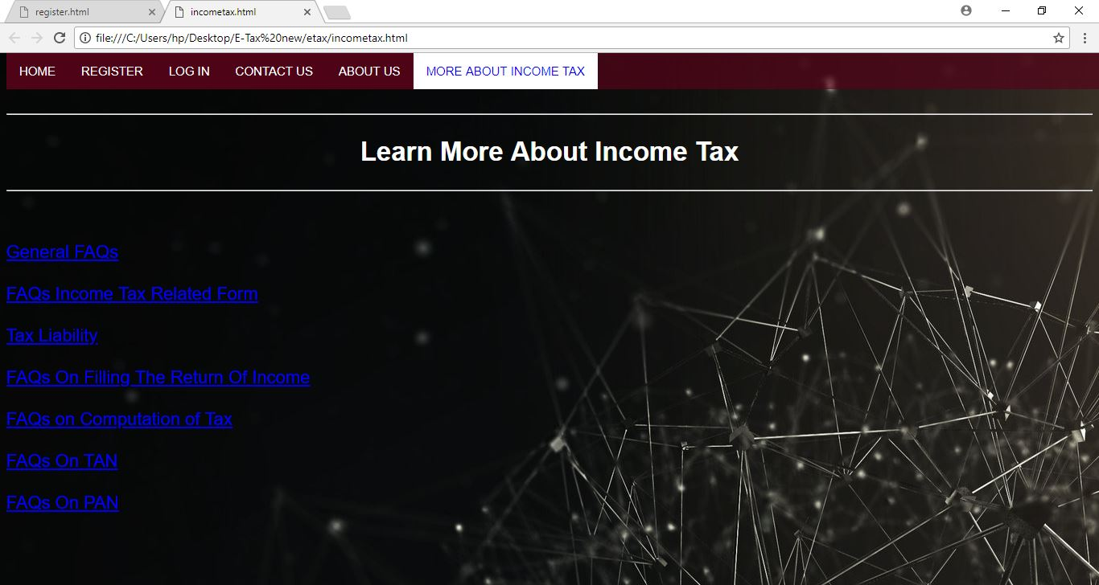
MORE ABOUT INCOME TAX

Slide 8
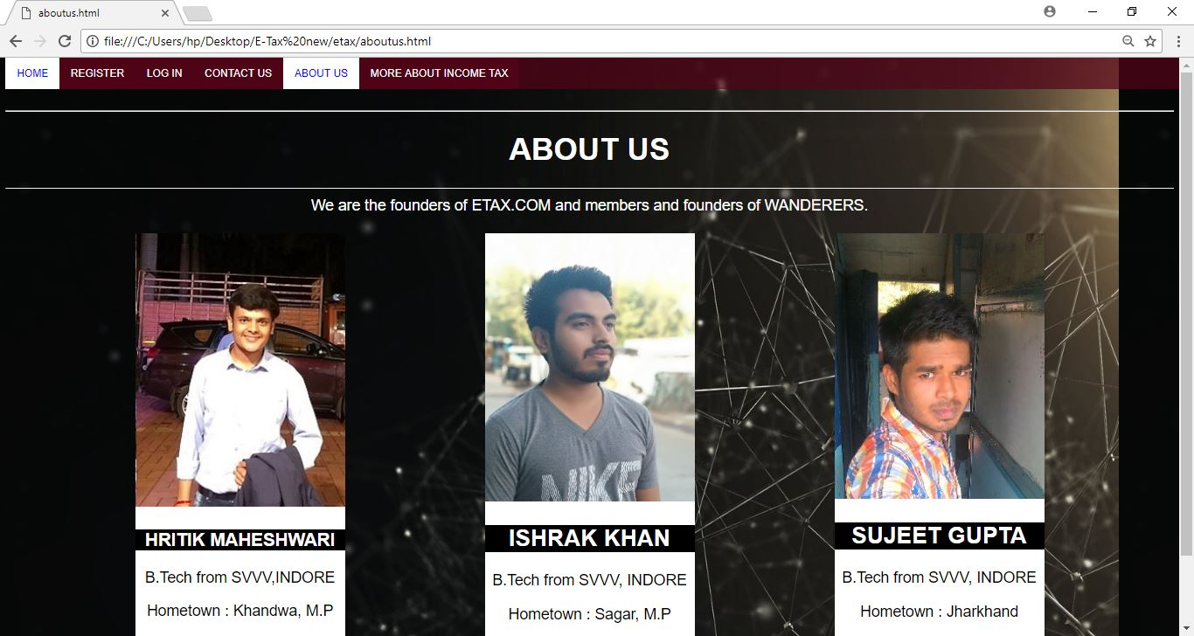
TEAM WANDERERS

